Slide 1
PUBG Project Analysis

Slide 2
Features effect on win chance

Slide 3
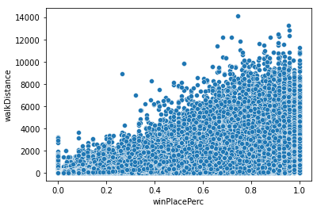
Does walking more increase chances of winning?
Walking appears to have a high correlation to winning in a lot of cases. This could be due to the fact that more distance traveled could have to do with more time alive in the match.

Slide 4
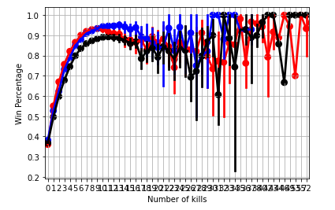
Does getting more kills help you win?
As we can see getting more kills only increases your chances of winning until about eight kills. Past that seems to fluctuate wildly and the higher in kills you go. This could have to do with players who play fast and pay little attention to strategies such as hiding or getting a key position.

Slide 5
Catching Cheaters

Slide 6
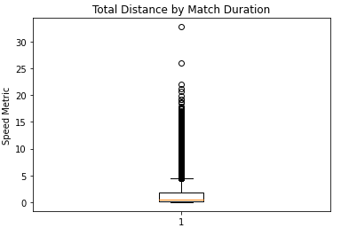
Catching Cheaters in PUBG: Speed Hack
Speed Hacking is the term used for a hack that allows players to exceed maximum speed set by the game. This cheat allows players to reach key destinations faster and get advantages. This metric shows the distance a player traveled by the matches duration. A suggestion could be to more deeply look into games where this metric exceeds ten.

Slide 7
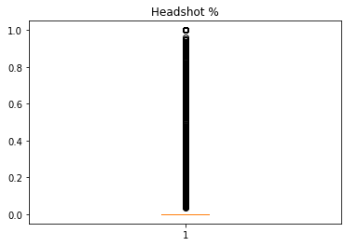
Catching Cheaters in PUBG: AimBot
Aimbot is a term used for software that allows players to have the aiming aspect of shooters taken away from them. The software will aim your mouse leaving you with just the job of moving and shooting. This metric shows the percent of headshots vs all shots as aimbots tend to hit the head. Using this metric and a little domain knowledge any match over 80% with more than 1 kill is probably using some form of aimbot.

Slide 8
Model building and deployment

Slide 9
Splitting the data
The data was split into three different categories for model building. These were chosen based on match type as each different match type in game is a different game mode. As such the data was split into a three datasets, one for solo queue matches, one for duo queue matches and finally one for squad queue matches.

Slide 10
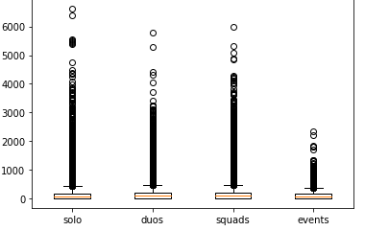
Handling missing data and Outliers
Damage Dealt
Upon visualizations and calculations it was discovered that outliers made up less than 1% of each dataset. Using this knowledge it was decided to remove outliers from the dataset as well as the single row with missing data that was found,.

Slide 11
EDA and Normalization
After further EDA it was decided to normalize the data. It was also decided to perform some feature engineering to reduce the amount of data down to a more usable amount.

Slide 12
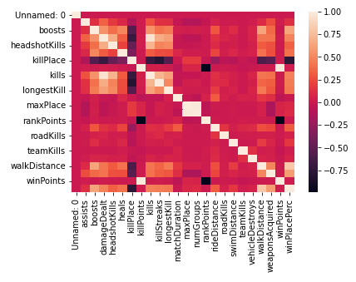
Multicollinearity and Feature Significance
Correlation Heat Map
A heat map was used to visualize if there was any multicollinearity issues. It was also decided to remove features that were over .8 threshold of correlated.

Slide 14
Model Building

Slide 15
Deployment Demo
Now let’s take a quick minute to show a demo of the deployment of the win prediction model before wrapping up.

Slide 16
Thank you for viewing our project!

